Slide 1
This slide is hidden.
Insert the starting slides after this slide

Slide 2
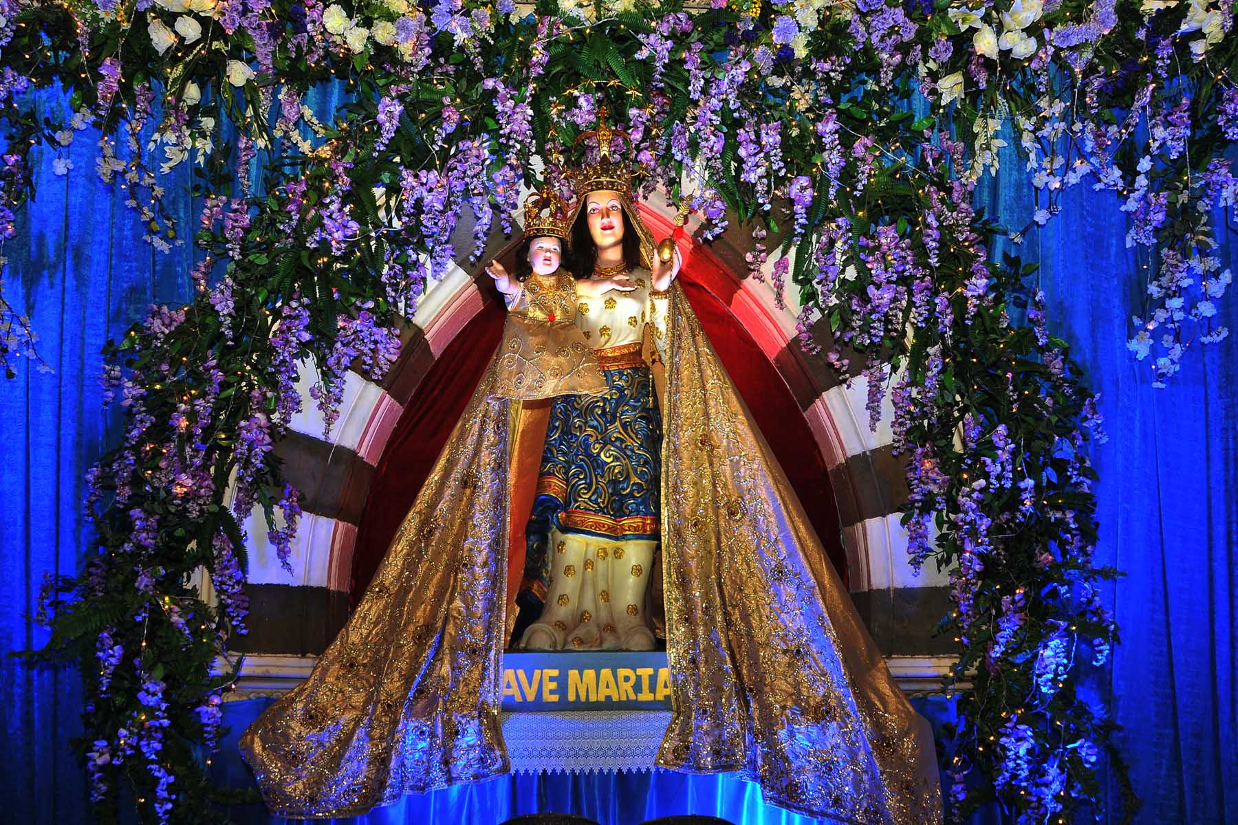
Feast of Our Lady

Slide 3


Slide 4
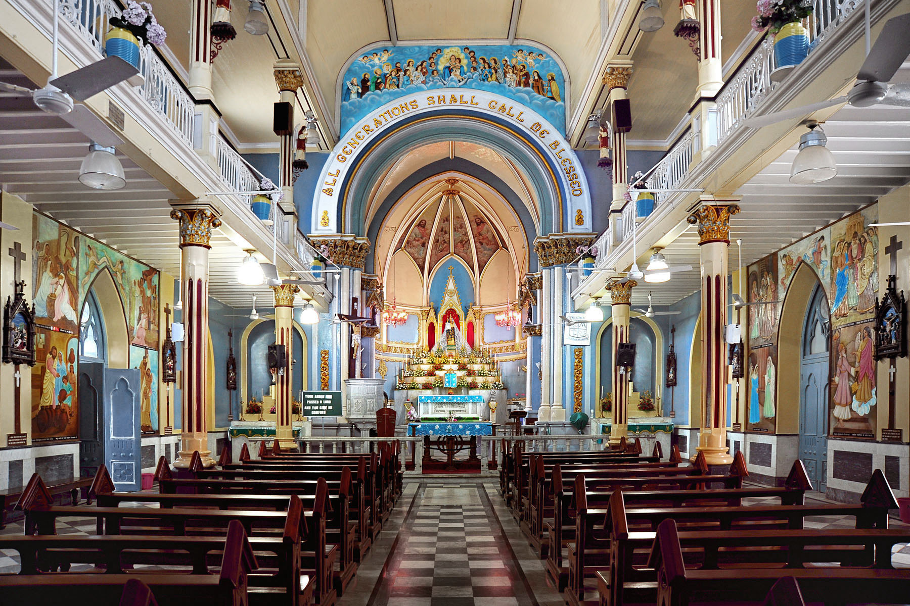

Slide 5
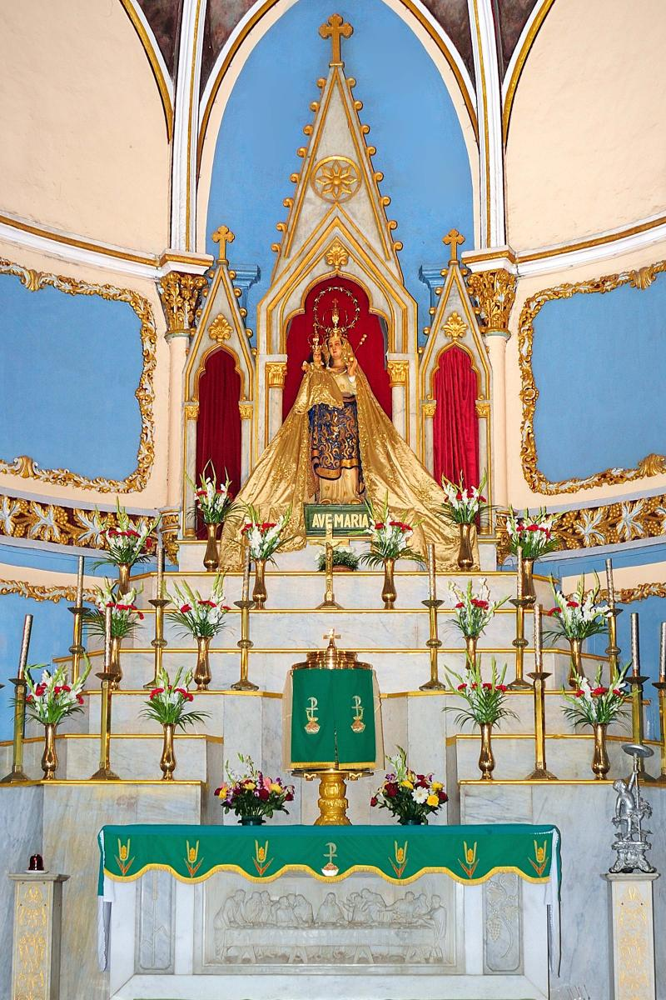

Slide 6
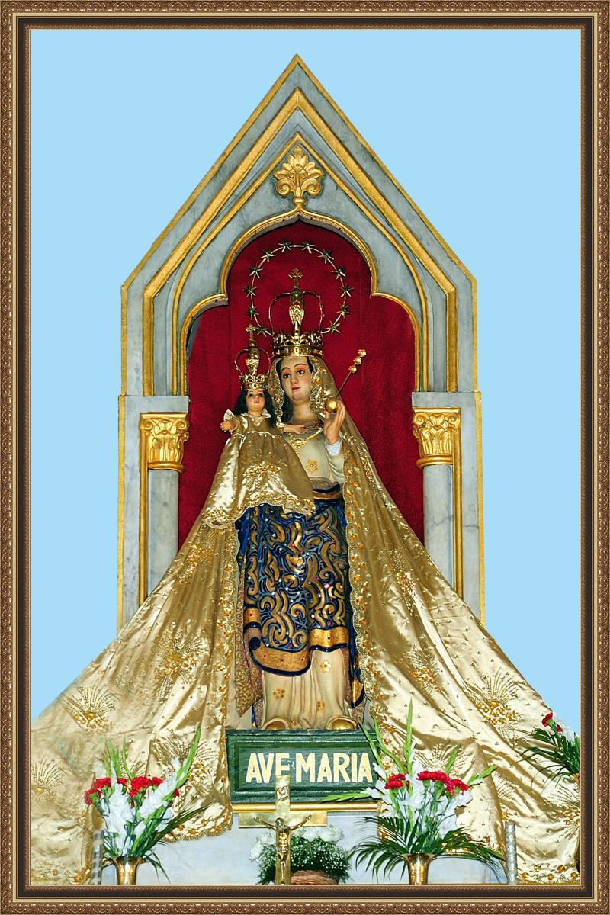

Slide 7
Please Stand

Slide 8
This slide is hidden.
Insert the Entrance Hymn after this slide

Slide 9
Hail Mary
Hail Mary full of grace,
The lord is with thee,
Blessed are you among women
And blest is the fruit of your womb,
Jesus. (Jesus)

Slide 10
Holy Mary, mother of God
Prayer for us sinner now, and at the hour of our death,
Amen. (Amen)

Slide 11
Gentle woman, quiet light,
Morning star so strong and bright
Gentle Mother, peaceful dove,
Teach us wisdom, teach us love.

Slide 12
You were chosen by the Father;
You were chosen for the Son.
You were chosen from all women
And for woman, shining one.

Slide 13
Gentle woman, quiet light,
Morning star so strong and bright
Gentle Mother, peaceful dove,
Teach us wisdom, teach us love.

Slide 14
Blessed are you among women
Blest in turn, all women too
Blessed they with peaceful spirits
Blessed they with gentle hearts

Slide 15
Gentle woman, quiet light,
Morning star so strong and bright
Gentle Mother, peaceful dove,
Teach us wisdom, teach us love.

Slide 17
Confiteor
I confess to almighty God
And to you, my brothers and sisters,
That I have greatly sinned
In my thoughts and in my words

Slide 18
In what I have done
And in what I have failed to do,
Through my fault,
Through my fault,
Through my most grievous fault;

Slide 19
Therefore I ask blessed Mary ever-Virgin,
All the Angels and Saints,
And you, my brothers and sisters,
To pray for me to the Lord our God.

Slide 21
Kyrie eleison
Kyrie eleison (2)
Christe eleison (2)
Kyrie eleison (2)

Slide 23
Gloria
Glory to God in the highest,
and on earth peace to people of good will.
We praise you, we bless you,
we adore you, we glorify you,

Slide 24
We give you thanks for your great glory,
Lord, God heavenly king,
O God, almighty father

Slide 25
Glory to God in the highest,
and on earth peace to people of good will.

Slide 26
Lord Jesus Christ, Only Begotten Son,
Lord God, Lamb of God, Son of the Father,
you take away the sins of the world,
have mercy on us;

Slide 27
you take away the sins of the world, receive our prayer;
you are seated at the right hand of the Father,
have mercy on us.

Slide 28
Glory to God in the highest,
and on earth peace to people of good will.

Slide 29
For you alone are the Holy One,
you alone are the Lord,
you alone are the Most High, Jesus Christ,
with the Holy Spirit,
in the glory of God the Father.

Slide 30
Glory to God in the highest,
and on earth peace to people of good will.
Amen.

Slide 32
Responsorial Psalm
Tell out my soul
The greatness of the Lord!
Unnumbered blessings give my spirit voice
Tender to me the promise of his word
In God my saviour shall my heart rejoice

Slide 33
Tell out my soul
The greatness of his name!
Make known his might, the deeds his arm has done
His mercy sure, from age to age the same
His holy name the Lord, the mighty One

Slide 34
Tell out my soul
The greatness of his might!
Pow'rs and do minions lay their glory by
Proud hearts and stubborn wills are put to flight
The hungry fed, the humble lifted high

Slide 35
Tell out my soul
The greatness of the Lord!
Unnumbered blessings give my spirit voice
Tender to me the promise of his word
In God my saviour shall my heart rejoice

Slide 36
Responsorial Psalm
Do not forget the works of the Lord.

Slide 38
Alleluia
Alleluia!
O blessed be the name of the Lord
Alleluia!
We worship you most high.

Slide 39
Your majesty we'll sing
Through out eternity
Alleluia!
We worship you most high.

Slide 41
Apostles Creed
I believe in God,
the Father almighty,
Creator of heaven and earth,
and in Jesus Christ, his only Son, our Lord,
(At the words that follow, up to and including the Virgin Mary, all bow.)

Slide 42
who was conceived by the Holy Spirit,
born of the Virgin Mary,
suffered under Pontius Pilate,
was crucified, died and was buried;
he descended into hell;

Slide 43
on the third day he rose again from the dead;
he ascended into heaven,
and is seated at the right hand of God the Father almighty;

Slide 44
from there he will come to judge the living and the dead.
I believe in the Holy Spirit,
the holy catholic Church,

Slide 45
the communion of saints,
the forgiveness of sins,
the resurrection of the body,
and life everlasting.
Amen.

Slide 47
First Collection
This collection goes to the Bishop
for the support of the Diocese.
Thank you for your contribution

Slide 49
This slide is hidden.
Insert the Offertory Hymn after this slide.

Slide 50

Lord, I offer my life
All that I am, all that I have
I lay them down before you, oh Lord
All my regrets, all my acclaims
The joy and the pain,
I'm making them yours

Slide 51
Lord, I offer my life to you
Everything I've been through
Use it for your glory

Slide 52
Lord I offer my days to you
Lifting my praise to you
As a pleasing sacrifice
Lord I offer you my life

Slide 53
Things in the past, things yet unseen
Wishes and dreams
that are yet to come true
All of my hopes, all of my plans
My heart and my hands are lifted to you

Slide 54
Lord, I offer my life to you
Everything I've been through
Use it for your glory

Slide 55
Lord I offer my days to you
Lifting my praise to you
As a pleasing sacrifice
Lord I offer you my life

Slide 56
What can we give that you have not given?
And what do we have
That is not already yours?
All we possess are these lives we're living
That's what we give to you, Lord

Slide 57
Lord, I offer my life to you
Everything I've been through
Use it for your glory

Slide 58
Lord I offer my days to you
Lifting my praise to you
As a pleasing sacrifice
Lord I offer you my life

Slide 60
Priest: Pray my brothers and sisters,
that my sacrifice and yours may be
acceptable to God, the almighty Father.
All: May the Lord accept the sacrifice
at your hands for the praise and glory of his name, for our good and the good of all his holy Church.

Slide 61
Priest: The Lord be with you.
All: And with your spirit.
Priest: Lift up your hearts.
All: We lift them up to the Lord.

Slide 62
Priest: Let us give thanks to the
Lord our God.
All: It is right and just.

Slide 64
Holy
Holy, Holy, Holy Lord God of hosts,
Heaven and earth are full of your glory. Hosanna in the highest
Blessed is he who comes
in the name of Lord,
Hosanna in the highest.

Slide 66
Memorial acclamation
Save us saviour of the world,
For by your cross and resurrection,
You have set us free

Slide 67
Memorial acclamation
When we eat this bread
And drink this cup
We proclaim your death O Lord
Until you come again

Slide 68
Memorial acclamation
We proclaim your death O Lord
And profess your resurrection
Until you come again

Slide 70
Amen
Amen, amen, amen, amen.
Amen, amen, amen, amen.

Slide 72
Priest: The Lord be with you.
All: And with your spirit

Slide 74
Peace
May the peace of the Lord be with you
With your friends and your family too
Let it be, let it grow
And everywhere you go
May the peace of the Lord follow you

Slide 75
Lamb of God
Lamb of God, lamb of God
You take away the sins of the world
Have mercy on us, lamb of God

Slide 76
Lamb of God, lamb of God
You take away the sins of the world
Have mercy on us, lamb of God

Slide 77
Lamb of God, lamb of God
You take away the sins of the world
Grant us, grant us peace

Slide 79
Priest: Behold the Lamb of God, behold him
who takes away the sins of the world.
Blessed are those called to the supper of the Lamb.
All: Lord, I am not worthy
that you should enter under my roof,
but only say the word
and my soul shall be healed.

Slide 80
This slide is hidden.
Insert the Communion Hymns after this slide.

Slide 81
Panis Angelicus
Panis angelicus
Fit panis hominum
Dat panis coelicus
Figuris terminum

Slide 82
O res mirabilis
Man ducat Dominum
Pauper, pauper
Servus et humilis

Slide 83
Pauper, pauper
Servus et humilis

Slide 84
Panis angelicus
Fit panis hominum
Dat panis coelicus
Figuris terminum

Slide 85
O res mirabilis
Man ducat Dominum
Pauper, pauper
Servus et humilis

Slide 86
Pauper, pauper
Servus, servus et humilis

Slide 87
Ave Maria
Ave Maria, gratia plena
Dominus tecum,
Ave Maria

Slide 88
Benedicta tu
Benedicta tu in mulieribus
Et benedictus
Fructus ventris tui Jesus

Slide 89
Ave Maria,
Ave Maria

Slide 90
Santa Maria
Mater dei
Ora pro nobis peccatoribus

Slide 91
Nunc et in hora
Mortis nostrae amen

Slide 92
Ave Maria
Ave Maria
Ave

Slide 93
Salve Regina
Sal-ve Re-gi-na
Ma-ter mi-se-ri-cor-di-ae
Vi-ta dul-ce-do
Et spes nos-tra sal-ve

Slide 94
Ad te cla-ma-mus
Ex-su-les fi-li-i He-vae
Ad te sus-pi-ra-mus
Ge-men-tes et flen-tes
In hac la-cri-mar-um val-le

Slide 95
E-ia er-go
Ad-vo-ca-ta nos-tra
Il-os tu-os
Mi-se-ri-cor-des o-cu-los
Ad nos con-ver-te

Slide 96
Et Je-sum
Be-ne-di-ctum fru-ctum
Ven-tris tu-i
No-bis post hoc ex-si-li-um os-ten-de

Slide 97
O cle-mens
O pi-a
O dul-cis Vir-go Ma-ri-a

Slide 98
As I kneel before you
Dominus tecum benedicta tu
As I kneel before you
As I bow my head in prayer
Take this day, make it yours
And fill me with your love

Slide 99
Ave Maria, gratia plena
Dominus tecum benedicta tu

Slide 100
All I have I give you,
Every dream and wish are yours.
Mother of Christ, Mother of mine
Present them to my Lord

Slide 101
Ave Maria, gratia plena
Dominus tecum benedicta tu

Slide 102
As I kneel before you,
And I see your smiling face
Every thought, every word,
Is lost in your embrace.

Slide 103
Ave Maria, gratia plena
Dominus tecum benedicta tu
Dominus tecum benedicta tu

Slide 105
Second Collection
What you contribute now
is for the support of our
parish and its mission.
Thank you for your generosity

Slide 106
This slide is hidden.
Insert the Notices for the week after this slide

Slide 107
This slide is hidden.
The next slide can be used for videos.
Insert the video into the slide.

Slide 109
Priest: The Lord be with you.
All: And with your spirit.

Slide 111
This slide is hidden.
Insert the Recessional Hymns after this slide.

Slide 112
Our Lady of the Southern Cross
You said your ‘yes’ to the angel’s word
The spirit of God was with you
You walked with jesus throughout his life,
With a mother’s care and trust

Slide 113
You stood at last beneath the cross
A model of courage and strength
Teach us to hope,
to believe and love like you,
Our lady of the southern cross.

Slide 114
Shine upon us,
Guide us through life,
Show us the way to Christ your son
Shine upon us guide us through life,
Mother of Jesus mother of Christ.

Slide 115
You sat and prayed with his closest friends
Awaiting the spirit to come.
You saw them change as they went transformed
To a world they hardly knew.

Slide 116
Now stand with us, O mother of light,
As we speak God’s love and truth
Teach us to hope,
to believe and love like you,
Our lady of the southern cross.

Slide 117
Shine upon us,
Guide us through life,
Show us the way to Christ your son
Shine upon us guide us through life,
Mother of Jesus mother of Christ

Slide 118
This slide is hidden.
Insert the final slide here.

